Slide 1
How to use the GCWE Scheduler

Slide 2
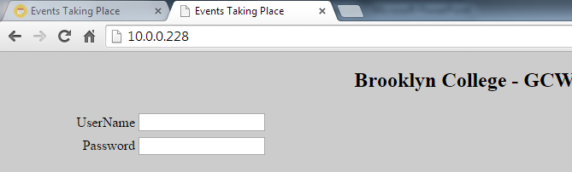
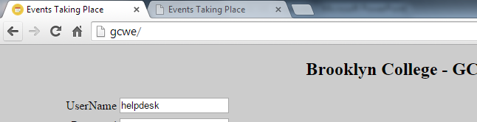
How to access the site:
Type in browser URL:
Use IP Address: 10.0.0.228
Use name: gcwe/
Must be manually set on the computer

Slide 3
Home Page
View all events taking place.
View “free times” table.
View staff hours.
Login in.

Slide 4
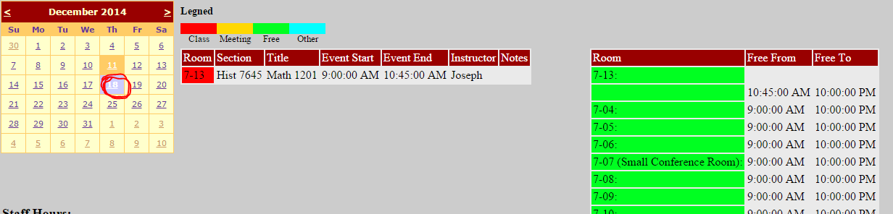
How to view events:
Simply click on a date on the calendar.
If any events are taking place on that day it will display in the table on the left.
The free time table
When a date is selected a table on the right will appear along with the one on the left.

Slide 5
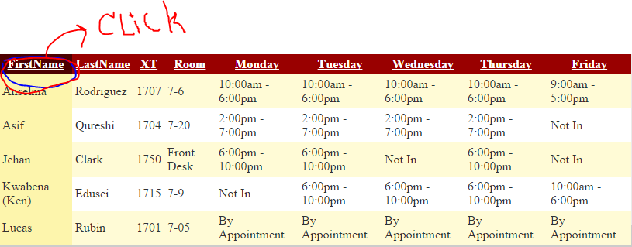
Staff Hours:
The Staff Hours table:
Displays the staff and their availability information
The rows can be rearranged when clicking on column name.

Slide 6
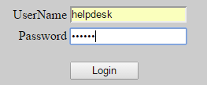
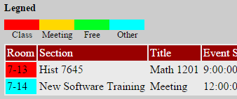
Logging in + Legends:
Each staff member has their own account
Legend is color coded to show what type of event it is.

Slide 7
Schedule Event Page:
View all events
Link to edit all events
Link to edit staff schedule
Form to add an event

Slide 8
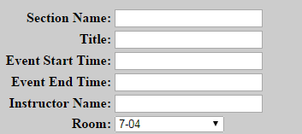
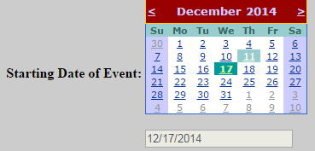
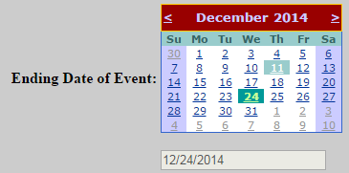
How to schedule Event:
All fields must be filled.
Event Start Time and Event End Time must be in a time format with pm or am at the end (ex. 10:45am)
Select what day you want to start and end the event.
The textboxes are automatically updated so you don’t have to.

Slide 9
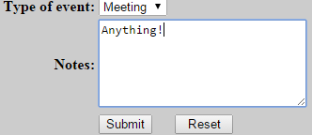
How to Schedule Event (cont.):
Repeat means if you want it to display more than one day.
Days to repeat (there must be at least one day):
Type of event (class, meeting, other):
Notes: Any Additional information.

Slide 10
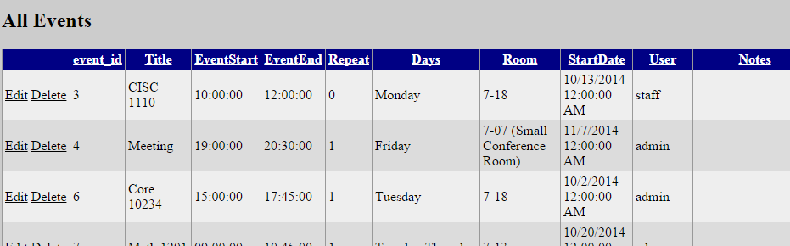
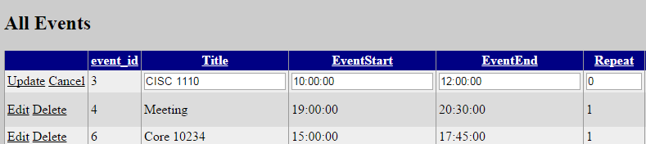
Edit all Events:
Normal View:
Editing View:
Deleting:
Once you press the delete button, the record deletes. Cannot be undone!

